Slide 1
Today
Non-PV work
Definition
Electrical work associated with moving around single ions, moles of ions
Concentration work
Context for CGI exercises
Relationship to Gibbs and the 2nd Law

Slide 2
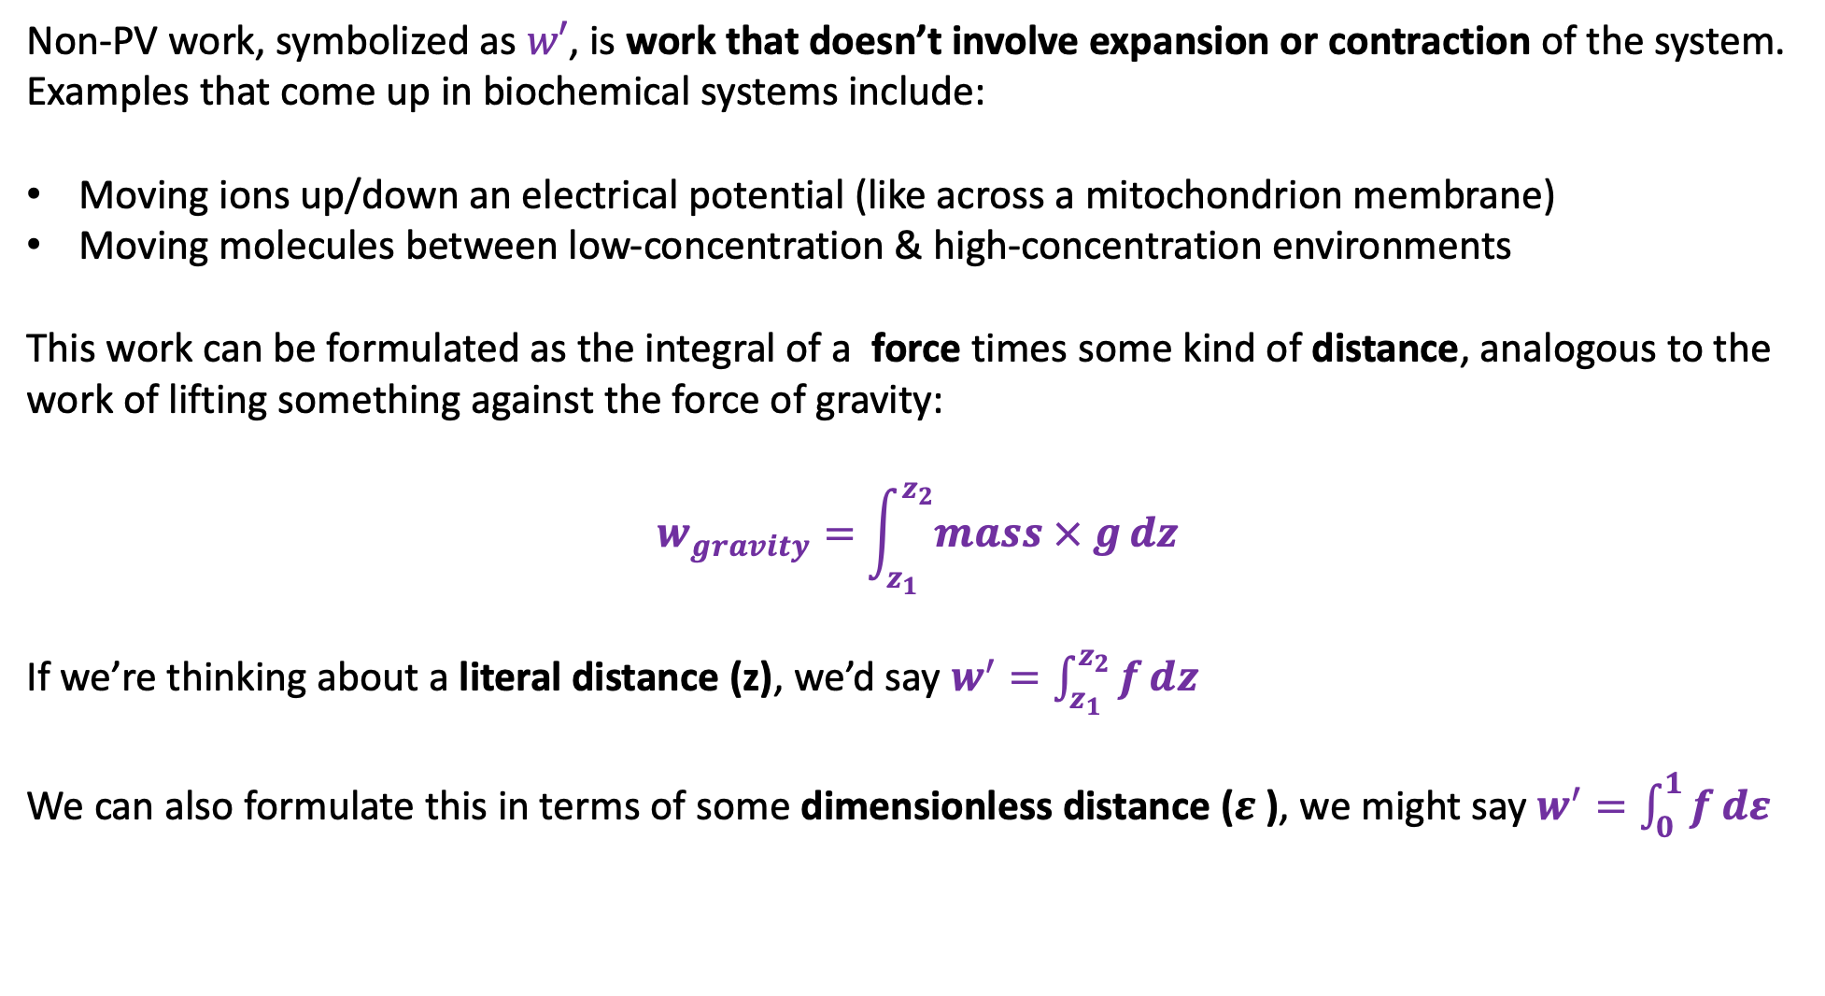
Definition of non-PV work
Non-PV work, symbolized as $w′$, is work that doesn’t involve expansion or contraction of the system. Examples that come up in biochemical systems include:
Moving ions up/down an electrical potential (like across a mitochondrion membrane)
Moving molecules between low-concentration & high-concentration environments
This work can be formulated as the integral of a force times some kind of distance, analogous to the work of lifting something against the force of gravity:
$$w_{gravity}=\int_{z_{1}}^{z_{2}}{mass × g}dz$$
If we’re thinking about a literal distance (z), we’d say $w^{′}=\int_{z_{1}}^{z_{2}}{f}dz$
We can also formulate this in terms of some dimensionless distance ($ε$ ), we might say $w^{′}=\int_{0}^{1}{f}dε$

Slide 3
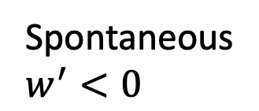


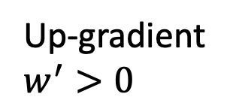




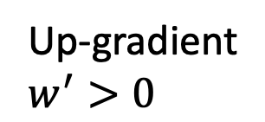

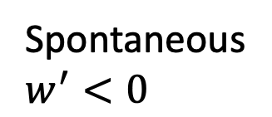

Electrical work for single ions
The total work would be
$$w^{′}=Q\int_{z_{1}}^{z_{2}}{\frac{dφ}{dz}}dz$$
$f=Q\frac{dφ}{dz}$
$distance=z$
$$E.g., Q_{proton}=1.6×{10}^{−19} C$$
-
+
-
+
$$e^{−}$$
-
Up-gradient
$$w^{′}>0$$
Spontaneous
$$w^{′}<0$$
+
-
+
-
+
$$H^{+}$$
-
Spontaneous
$$w^{′}<0$$
Up-gradient
$$w^{′}>0$$
+
-
+
$$φ$$
$$∆φ$$
$$∆z$$
$$z$$

Slide 4
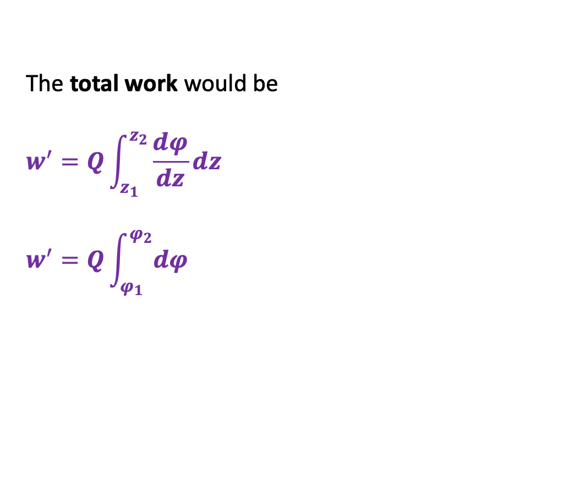
Electrical work for single ions
The total work would be
$$w^{′}=Q\int_{z_{1}}^{z_{2}}{\frac{dφ}{dz}}dz$$
$$w^{′}=Q\int_{φ_{1}}^{φ_{2}}{dφ}$$
$f=Q\frac{dφ}{dz}$
$distance=z$
$$E.g., Q_{proton}=1.6×{10}^{−19} C$$
-
+
-
+
$$e^{−}$$
-
Up-gradient
$$w^{′}>0$$
Spontaneous
$$w^{′}<0$$
+
-
+
-
+
$$H^{+}$$
-
Spontaneous
$$w^{′}<0$$
Up-gradient
$$w^{′}>0$$
+
-
+
$$φ$$
$$∆φ$$
$$∆z$$
$$z$$

Slide 5
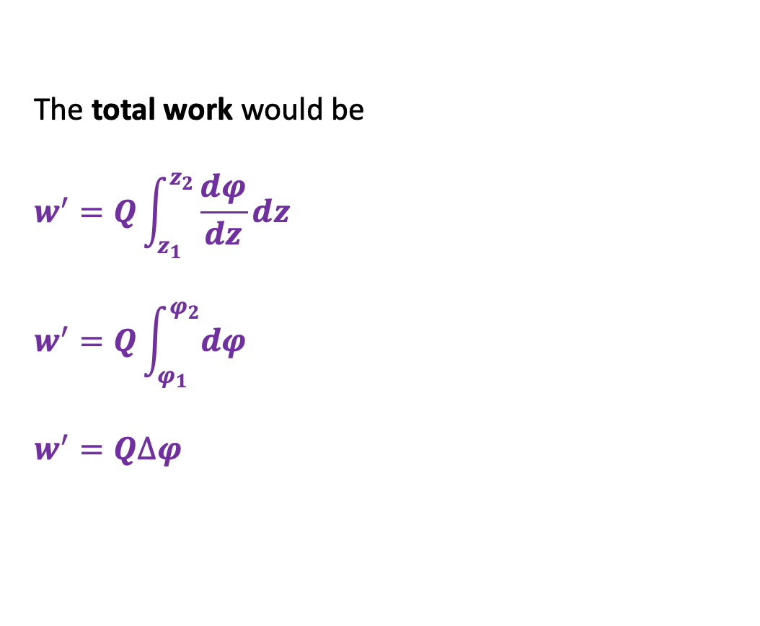
Electrical work for single ions
The total work would be
$$w^{′}=Q\int_{z_{1}}^{z_{2}}{\frac{dφ}{dz}}dz$$
$$w^{′}=Q\int_{φ_{1}}^{φ_{2}}{dφ}$$
$$w^{′}=Q∆φ$$
$f=Q\frac{dφ}{dz}$
$distance=z$
$$E.g., Q_{proton}=1.6×{10}^{−19} C$$
-
+
-
+
$$e^{−}$$
-
Up-gradient
$$w^{′}>0$$
Spontaneous
$$w^{′}<0$$
+
-
+
-
+
$$H^{+}$$
-
Spontaneous
$$w^{′}<0$$
Up-gradient
$$w^{′}>0$$
+
-
+
$$φ$$
$$∆φ$$
$$∆z$$
$$z$$

Slide 6
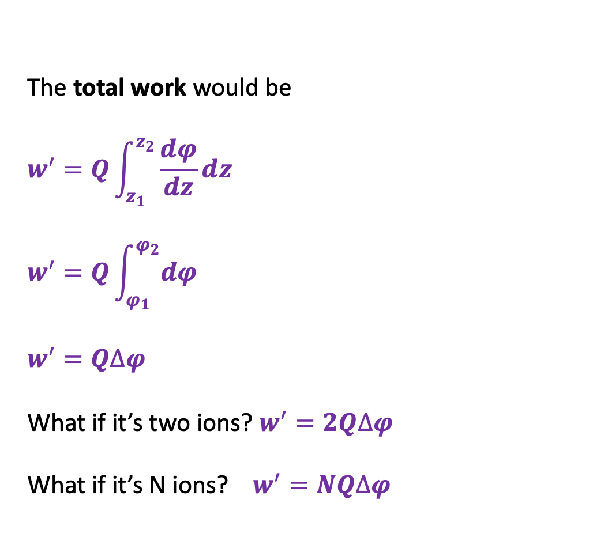
Electrical work for single ions
The total work would be
$$w^{′}=Q\int_{z_{1}}^{z_{2}}{\frac{dφ}{dz}}dz$$
$$w^{′}=Q\int_{φ_{1}}^{φ_{2}}{dφ}$$
$$w^{′}=Q∆φ$$
What if it’s two ions? $w^{′}=2Q∆φ$
What if it’s N ions? $w^{′}=NQ∆φ$
$f=Q\frac{dφ}{dz}$
$distance=z$
$$E.g., Q_{proton}=1.6×{10}^{−19} C$$
-
+
-
+
$$e^{−}$$
-
Up-gradient
$$w^{′}>0$$
Spontaneous
$$w^{′}<0$$
+
-
+
-
+
$$H^{+}$$
-
Spontaneous
$$w^{′}<0$$
Up-gradient
$$w^{′}>0$$
+
-
+
$$φ$$
$$∆φ$$
$$∆z$$
$$z$$

Slide 7
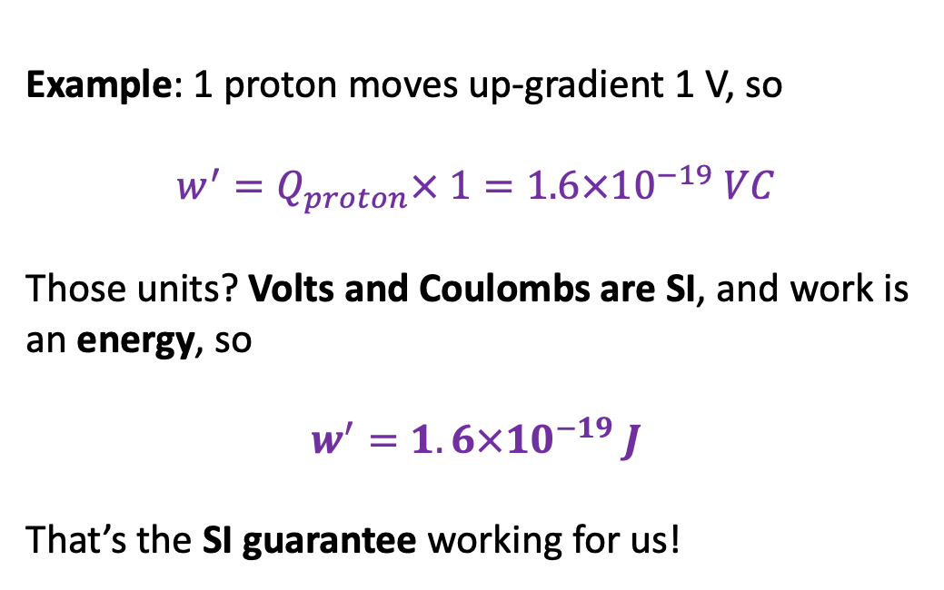
Electrical work for single ions
$f=Q\frac{dφ}{dz}$
$distance=z$
$$w^{′}=NQ∆φ$$
$$E.g., Q_{proton}=1.6×{10}^{−19} C$$
-
+
Example: 1 proton moves up-gradient 1 V, so
$$w^{′}=Q_{proton}× 1=1.6×{10}^{−19} VC$$
Those units? Volts and Coulombs are SI, and work is an energy, so
$$w^{′}=1.6×{10}^{−19} J$$
That’s the SI guarantee working for us!
-
+
$$e^{−}$$
-
Up-gradient
$$w^{′}>0$$
Spontaneous
$$w^{′}<0$$
+
-
+
-
+
$$H^{+}$$
-
Spontaneous
$$w^{′}<0$$
Up-gradient
$$w^{′}>0$$
+
-
+
$$φ$$
$$∆φ$$
$$∆z$$
$$z$$

Slide 8
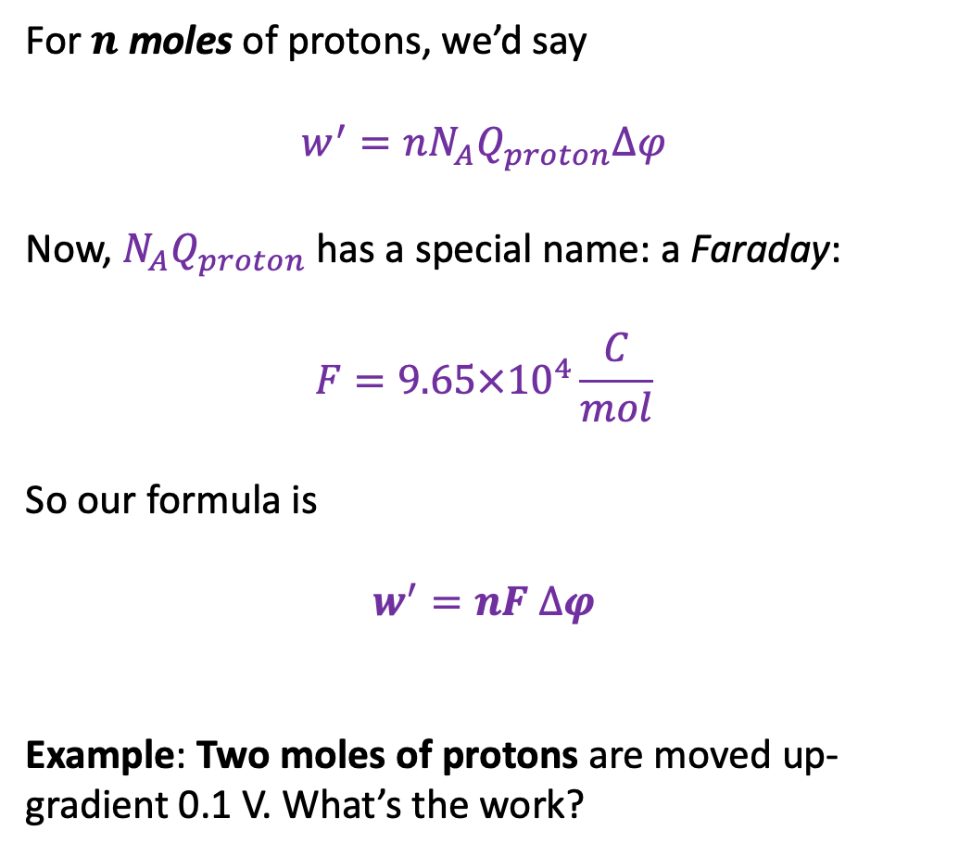
Electrical work for moles of ions
For $n$ moles of protons, we’d say
$$w^{′}={nN}_{A}Q_{proton}∆φ$$
Now, $N_{A}Q_{proton}$ has a special name: a Faraday:
$$F=9.65×{10}^{4}\frac{C}{mol}$$
So our formula is
$$w^{′}=nF ∆φ$$
Example: Two moles of protons are moved up-gradient 0.1 V. What’s the work?
$f=Q\frac{dφ}{dz}$
$distance=z$
-
+
-
+
$$e^{−}$$
-
Up-gradient
$$w^{′}>0$$
Spontaneous
$$w^{′}<0$$
+
-
+
-
+
$$H^{+}$$
-
Spontaneous
$$w^{′}<0$$
Up-gradient
$$w^{′}>0$$
+
-
+
$$φ$$
$$∆φ$$
$$∆z$$
$$z$$

Slide 9
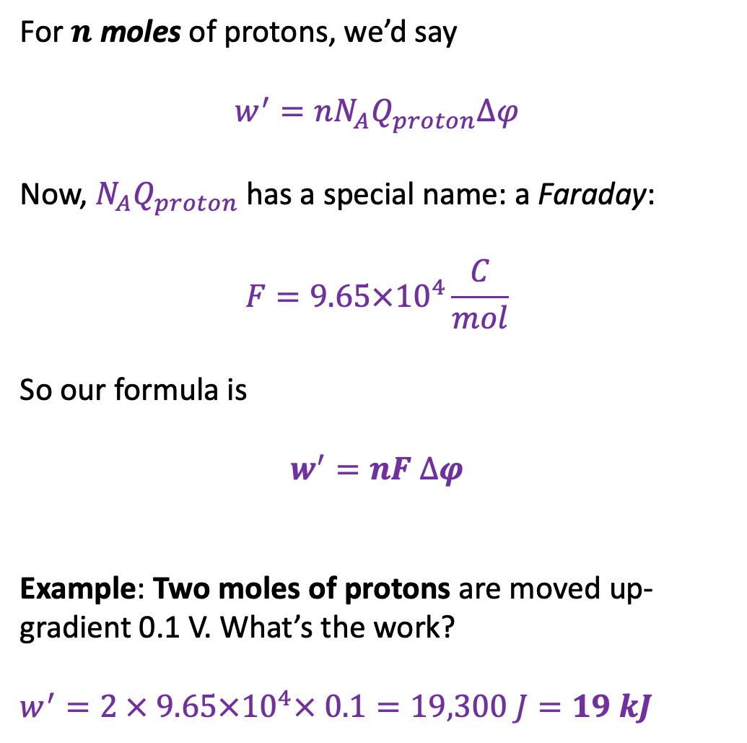
Electrical work for moles of ions
For $n$ moles of protons, we’d say
$$w^{′}={nN}_{A}Q_{proton}∆φ$$
Now, $N_{A}Q_{proton}$ has a special name: a Faraday:
$$F=9.65×{10}^{4}\frac{C}{mol}$$
So our formula is
$$w^{′}=nF ∆φ$$
Example: Two moles of protons are moved up-gradient 0.1 V. What’s the work?
$$w^{′}=2 × 9.65×{10}^{4}× 0.1=19,300 J=19 kJ$$
$f=Q\frac{dφ}{dz}$
$distance=z$
-
+
-
+
$$e^{−}$$
-
Up-gradient
$$w^{′}>0$$
Spontaneous
$$w^{′}<0$$
+
-
+
-
+
$$H^{+}$$
-
Spontaneous
$$w^{′}<0$$
Up-gradient
$$w^{′}>0$$
+
-
+
$$φ$$
$$∆φ$$
$$∆z$$
$$z$$

Slide 10

Electrical work for moles of ions
For $n$ moles of protons, we’d say
$$w^{′}={nN}_{A}Q_{proton}∆φ$$
Now, $N_{A}Q_{proton}$ has a special name: a Faraday:
$$F=9.65×{10}^{4}\frac{C}{mol}$$
So our formula is
$$w^{′}=nF ∆φ$$
Example: Two moles of Ca²⁺ ions are moved up-gradient 0.1 V. What’s the work?
$f=Q\frac{dφ}{dz}$
$distance=z$
-
+
-
+
$$e^{−}$$
-
Up-gradient
$$w^{′}>0$$
Spontaneous
$$w^{′}<0$$
+
-
+
-
+
$$H^{+}$$
-
Spontaneous
$$w^{′}<0$$
Up-gradient
$$w^{′}>0$$
+
-
+
$$φ$$
$$∆φ$$
$$∆z$$
$$z$$

Slide 11
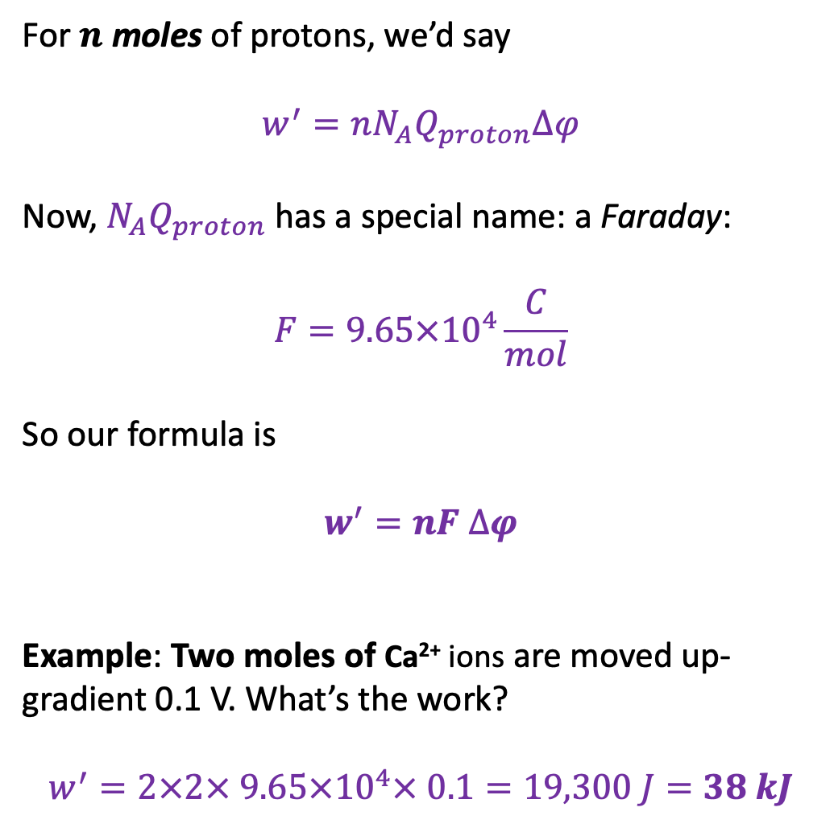
Electrical work for moles of ions
For $n$ moles of protons, we’d say
$$w^{′}={nN}_{A}Q_{proton}∆φ$$
Now, $N_{A}Q_{proton}$ has a special name: a Faraday:
$$F=9.65×{10}^{4}\frac{C}{mol}$$
So our formula is
$$w^{′}=nF ∆φ$$
Example: Two moles of Ca²⁺ ions are moved up-gradient 0.1 V. What’s the work?
$$w^{′}=2×2× 9.65×{10}^{4}× 0.1=19,300 J=38 kJ$$
$f=Q\frac{dφ}{dz}$
$distance=z$
-
+
-
+
$$e^{−}$$
-
Up-gradient
$$w^{′}>0$$
Spontaneous
$$w^{′}<0$$
+
-
+
-
+
$$H^{+}$$
-
Spontaneous
$$w^{′}<0$$
Up-gradient
$$w^{′}>0$$
+
-
+
$$φ$$
$$∆φ$$
$$∆z$$
$$z$$

Slide 12
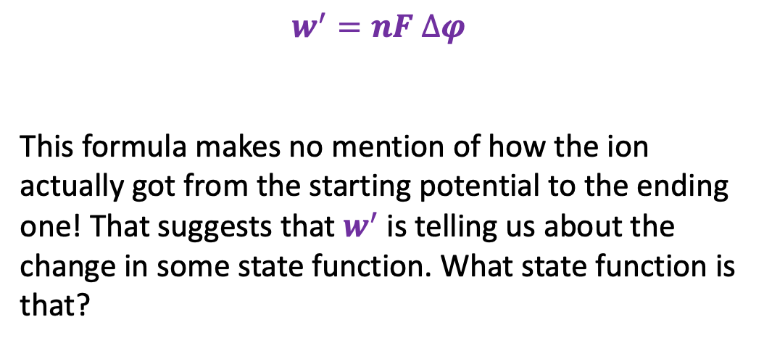
Path (in)dependence of electrical work?
$f=Q\frac{dφ}{dz}$
$distance=z$
$$w^{′}=nF ∆φ$$
This formula makes no mention of how the ion actually got from the starting potential to the ending one! That suggests that $w^{′}$is telling us about the change in some state function. What state function is that?
-
+
-
+
$$e^{−}$$
-
Up-gradient
$$w^{′}>0$$
Spontaneous
$$w^{′}<0$$
+
-
+
-
+
$$H^{+}$$
-
Spontaneous
$$w^{′}<0$$
Up-gradient
$$w^{′}>0$$
+
-
+
$$φ$$
$$∆φ$$
$$∆z$$
$$z$$

Slide 13
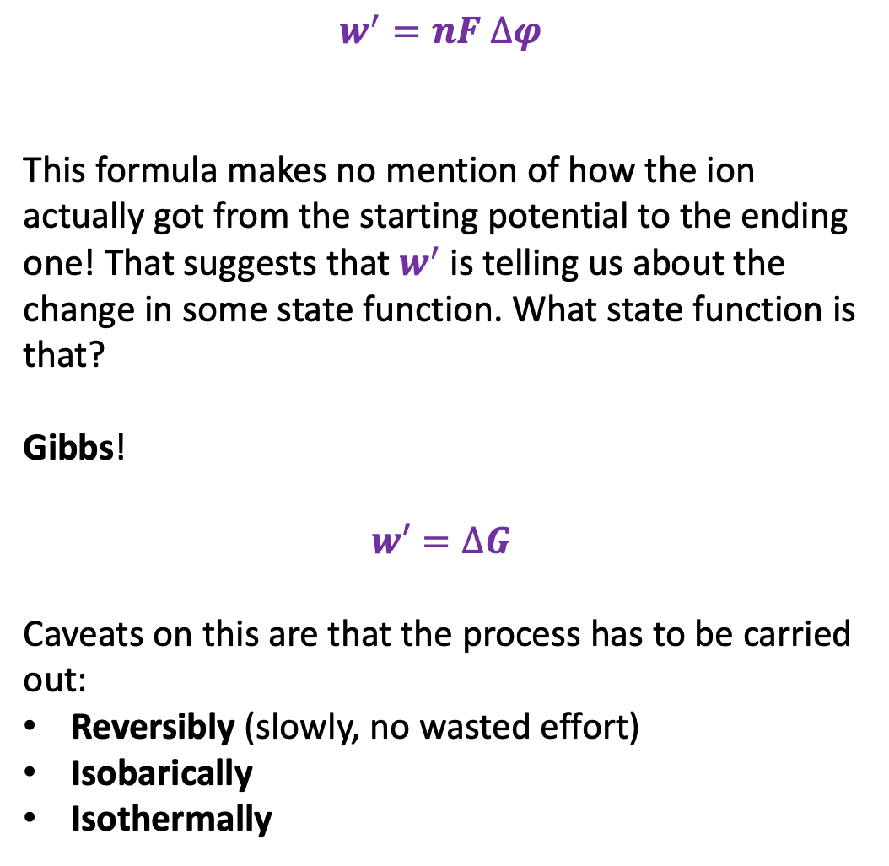
Path (in)dependence of electrical work?
$f=Q\frac{dφ}{dz}$
$distance=z$
$$w^{′}=nF ∆φ$$
This formula makes no mention of how the ion actually got from the starting potential to the ending one! That suggests that $w^{′}$is telling us about the change in some state function. What state function is that?
Gibbs!
$$w′=∆G$$
Caveats on this are that the process has to be carried out:
Reversibly (slowly, no wasted effort)
Isobarically
Isothermally
-
+
-
+
$$e^{−}$$
-
Up-gradient
$$w^{′}>0$$
Spontaneous
$$w^{′}<0$$
+
-
+
-
+
$$H^{+}$$
-
Spontaneous
$$w^{′}<0$$
Up-gradient
$$w^{′}>0$$
+
-
+
$$φ$$
$$∆φ$$
$$∆z$$
$$z$$

Slide 14
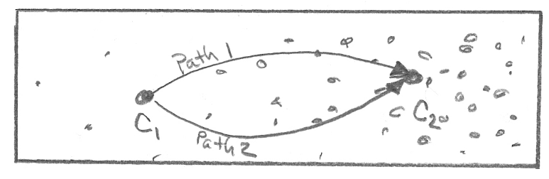
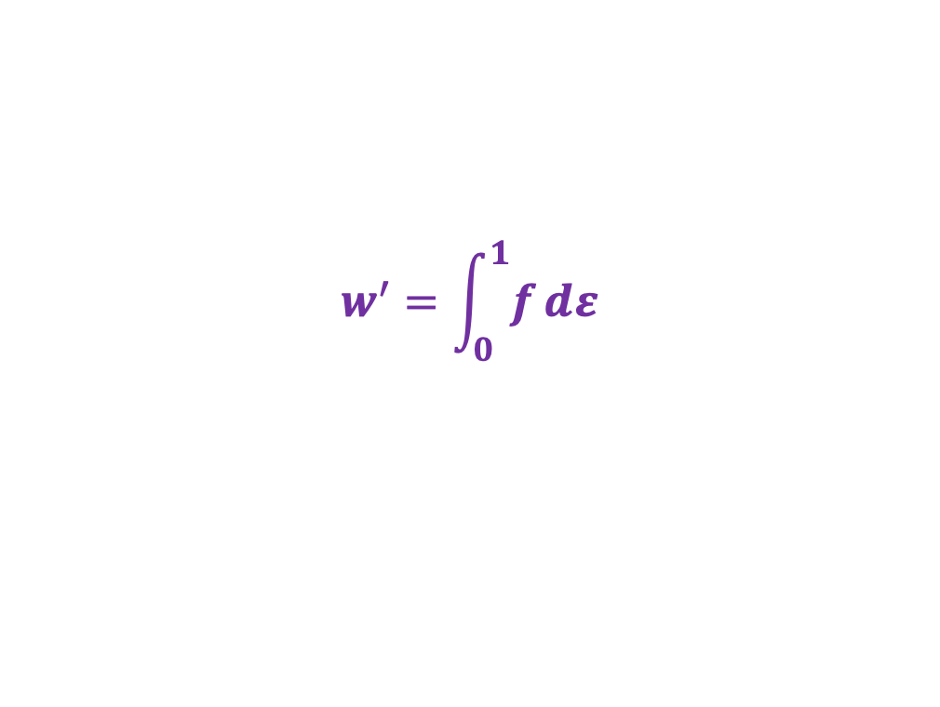
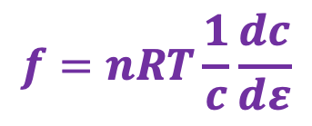


Concentration work as a force through a dimensionless “distance” $ε$
$$f=nRT\frac{1}{c}\frac{dc}{dε}$$
Force
$$w^{′}=\int_{0}^{1}{f}dε$$
Work
$$ε=1$$
$$ε=0$$

Slide 15


Concentration work as a force through a dimensionless “distance” $ε$
$$f=nRT\frac{1}{c}\frac{dc}{dε}$$
Force
$$w^{′}=\int_{0}^{1}{f}dε$$
Work
Question: Is there a state function that corresponds to this work?
$$ε=1$$
$$ε=0$$

Slide 16
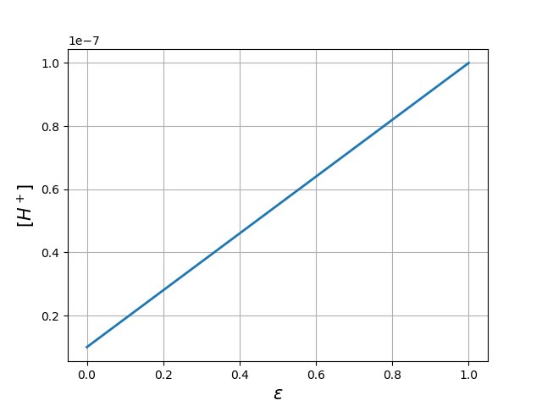
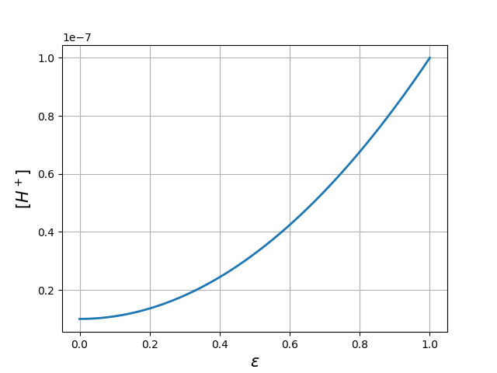
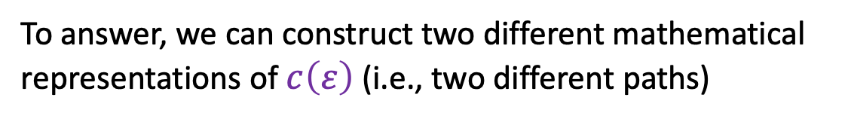


Concentration work as a force through a dimensionless “distance” $ε$
To answer, we can construct two different mathematical representations of $c\left(ε\right)$ (i.e., two different paths)
$$f=nRT\frac{1}{c}\frac{dc}{dε}$$
Force
$$Path 1$$
$$w^{′}=\int_{0}^{1}{f}dε$$
Work
Question: Is there a state function that corresponds to this work?
$$Path 2$$
$$ε=1$$
$$ε=0$$

Slide 17
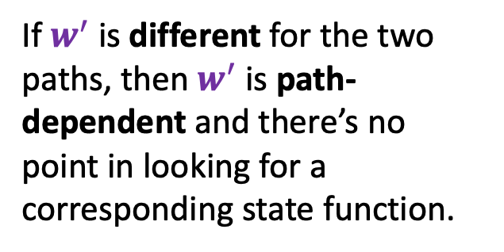


Concentration work as a force through a dimensionless “distance” $ε$
To answer, we can construct two different mathematical representations of $c\left(ε\right)$ (i.e., two different paths)
$$f=nRT\frac{1}{c}\frac{dc}{dε}$$
Force
If $w^{′}$ is different for the two paths, then $w^{′}$ is path-dependent and there’s no point in looking for a corresponding state function.
$$Path 1$$
$$w^{′}=\int_{0}^{1}{f}dε$$
Work
Question: Is there a state function that corresponds to this work?
$$Path 2$$
$$ε=1$$
$$ε=0$$

Slide 18
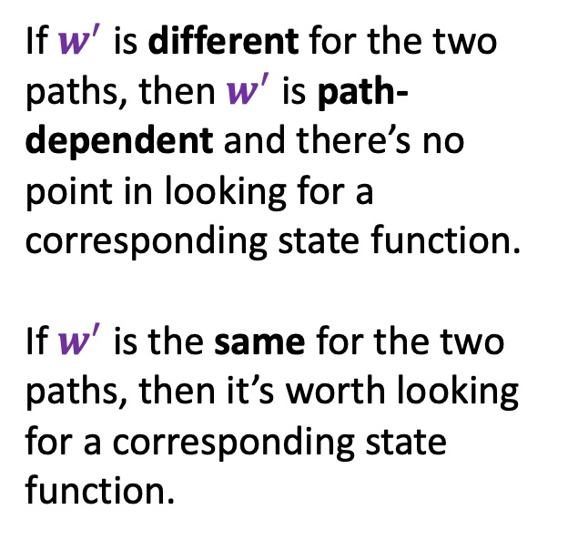
Concentration work as a force through a dimensionless “distance” $ε$
To answer, we can construct two different mathematical representations of $c\left(ε\right)$ (i.e., two different paths)
$$f=nRT\frac{1}{c}\frac{dc}{dε}$$
Force
If $w^{′}$ is different for the two paths, then $w^{′}$ is path-dependent and there’s no point in looking for a corresponding state function.
If $w^{′}$ is the same for the two paths, then it’s worth looking for a corresponding state function.
$$Path 1$$
$$w^{′}=\int_{0}^{1}{f}dε$$
Work
Question: Is there a state function that corresponds to this work?
$$Path 2$$
$$ε=1$$
$$ε=0$$

Slide 19
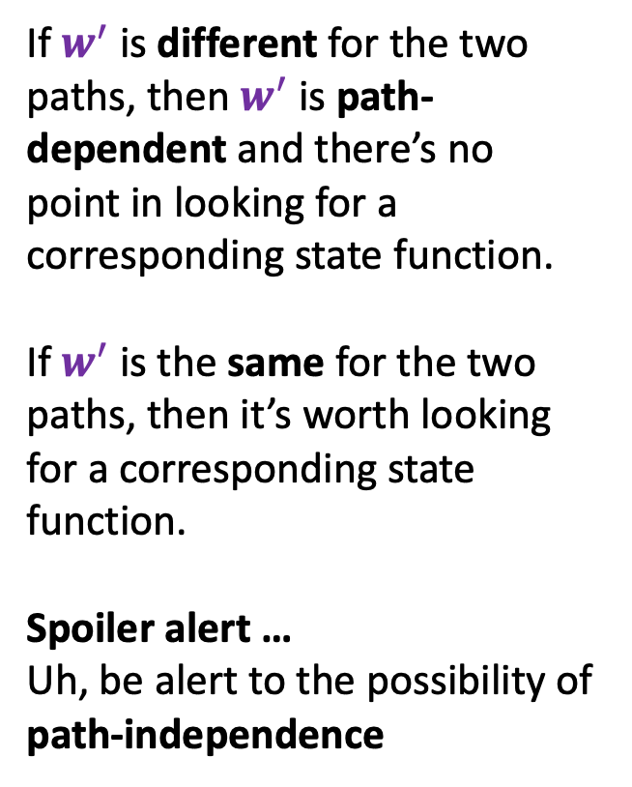
Concentration work as a force through a dimensionless “distance” $ε$
To answer, we can construct two different mathematical representations of $c\left(ε\right)$ (i.e., two different paths)
$$f=nRT\frac{1}{c}\frac{dc}{dε}$$
Force
If $w^{′}$ is different for the two paths, then $w^{′}$ is path-dependent and there’s no point in looking for a corresponding state function.
If $w^{′}$ is the same for the two paths, then it’s worth looking for a corresponding state function.
Spoiler alert …
Uh, be alert to the possibility of path-independence
$$Path 1$$
$$w^{′}=\int_{0}^{1}{f}dε$$
Work
Question: Is there a state function that corresponds to this work?
$$Path 2$$
$$ε=1$$
$$ε=0$$

Slide 20
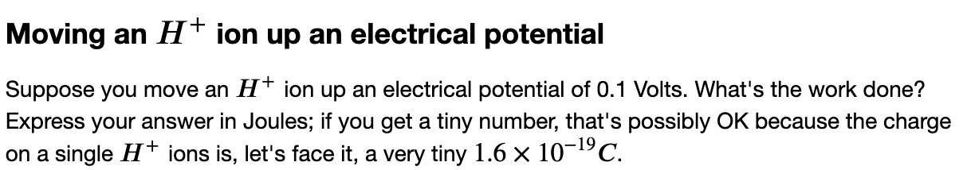

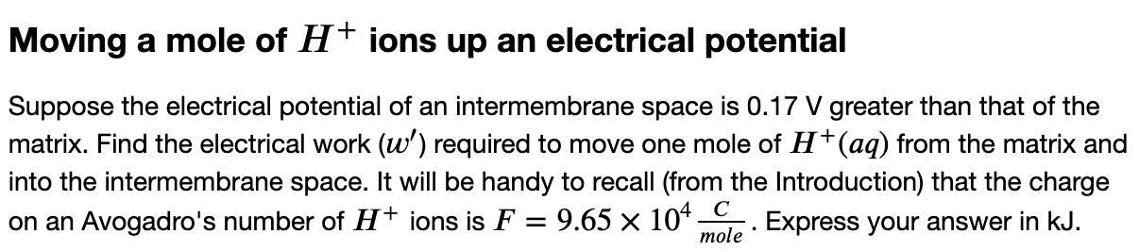
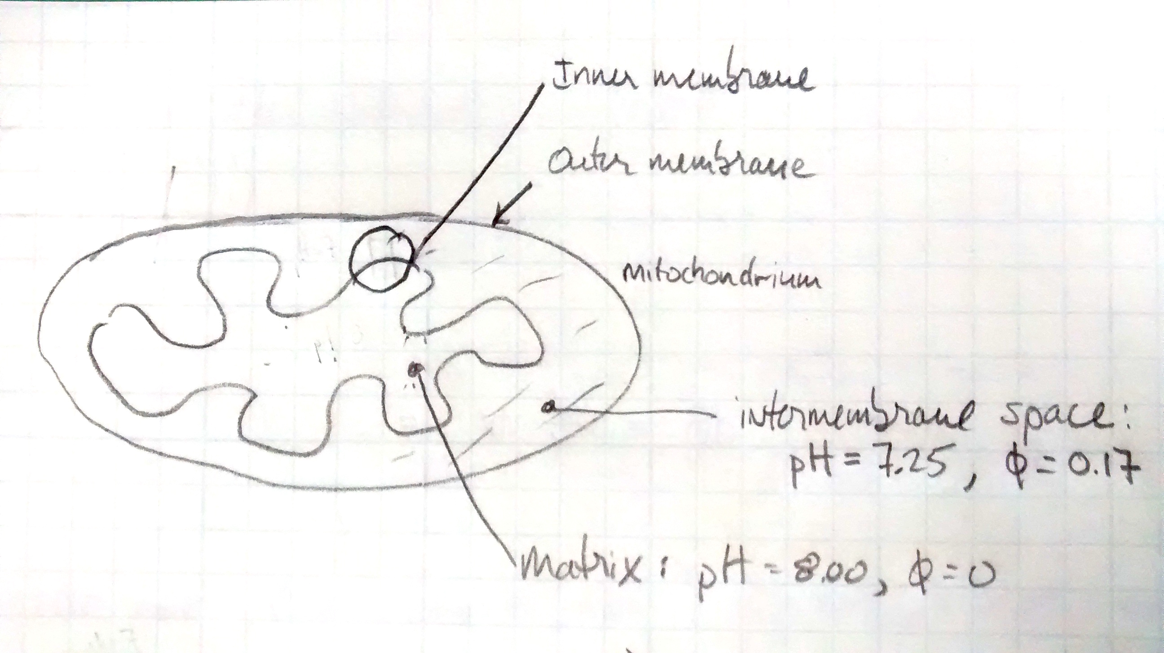


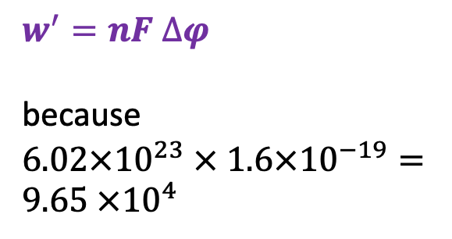
Context for CGI exercises
$$w^{′}=Q∆φ$$
$$w^{′}=5Q∆φ$$
$$w^{′}=nF ∆φ$$
because
$6.02×{10}^{23} × 1.6×{10}^{−19}=9.65 ×{10}^{4}$

Slide 21
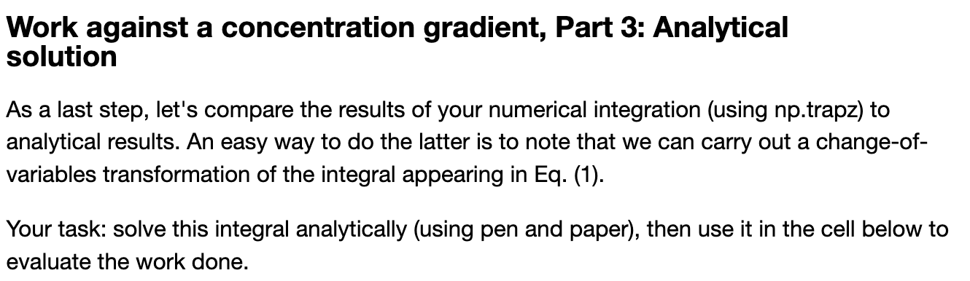
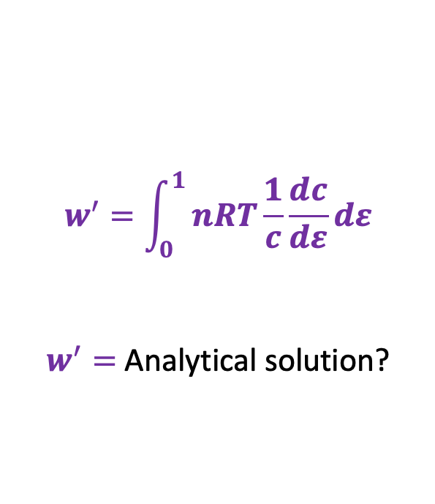
Context for CGI exercises
$$w^{′}=\int_{0}^{1}{nRT\frac{1}{c}\frac{dc}{dε}}dε$$
$w^{′}=$ Analytical solution?

Slide 22
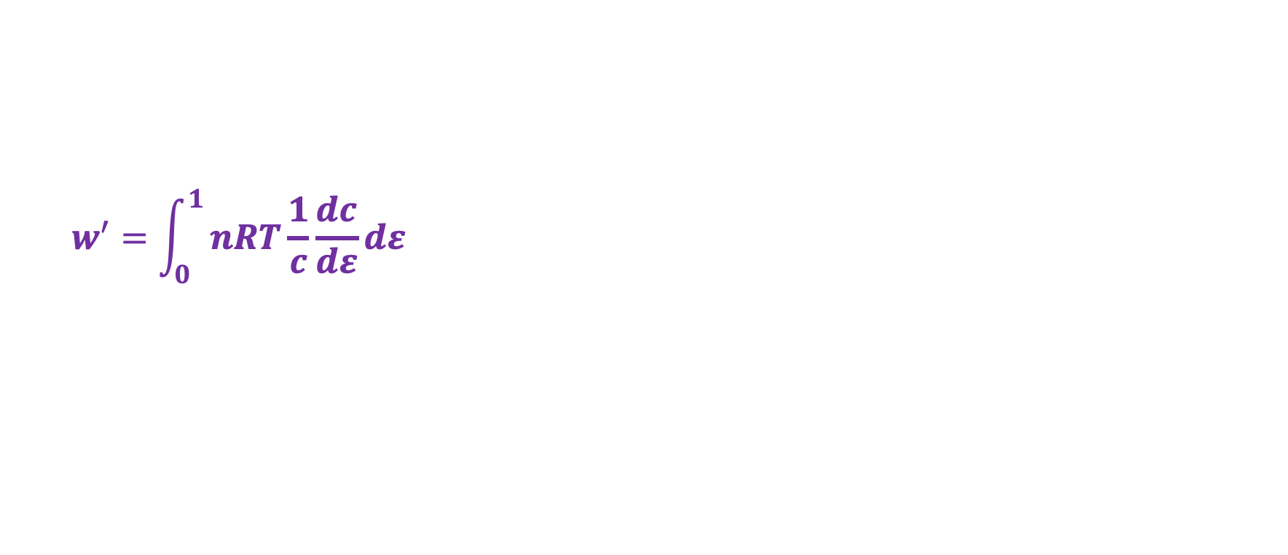
That analytical solution …
$$w^{′}=\int_{0}^{1}{nRT\frac{1}{c}\frac{dc}{dε}}dε$$
Constant temperature

Slide 23
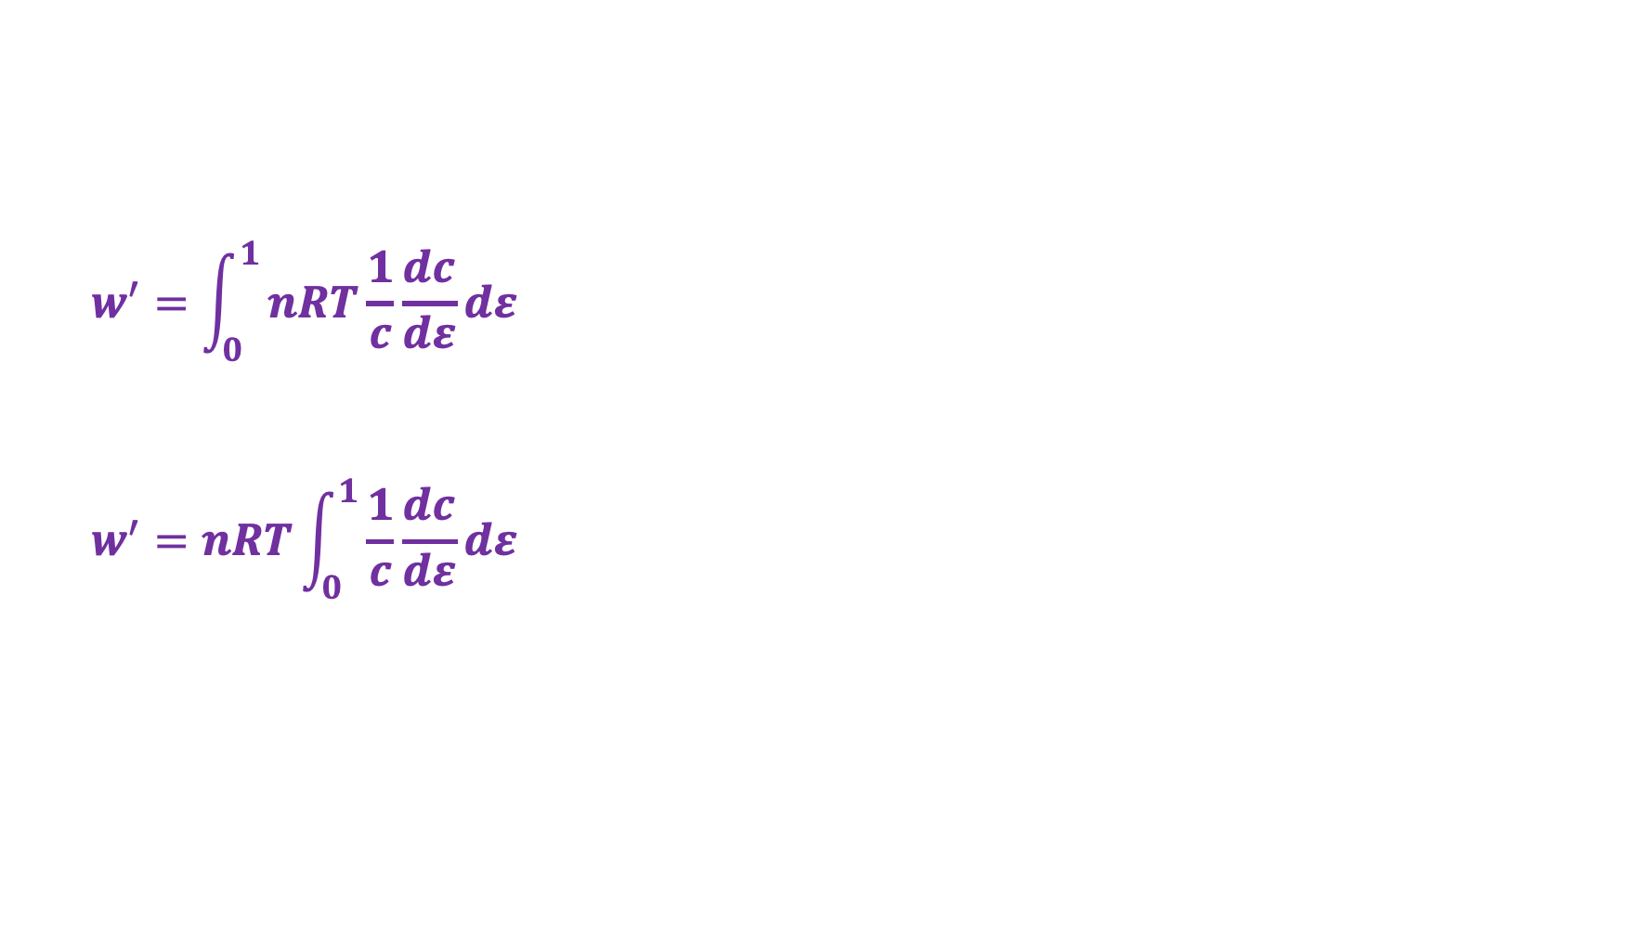
That analytical solution …
$$w^{′}=\int_{0}^{1}{nRT\frac{1}{c}\frac{dc}{dε}}dε$$
$$w^{′}=nRT\int_{0}^{1}{\frac{1}{c}\frac{dc}{dε}}dε$$
Constant temperature

Slide 24
That analytical solution …
$$w^{′}=\int_{0}^{1}{nRT\frac{1}{c}\frac{dc}{dε}}dε$$
$$w^{′}=nRT\int_{0}^{1}{\frac{1}{c}\frac{dc}{dε}}dε$$
Constant temperature
Variable substitution

Slide 25
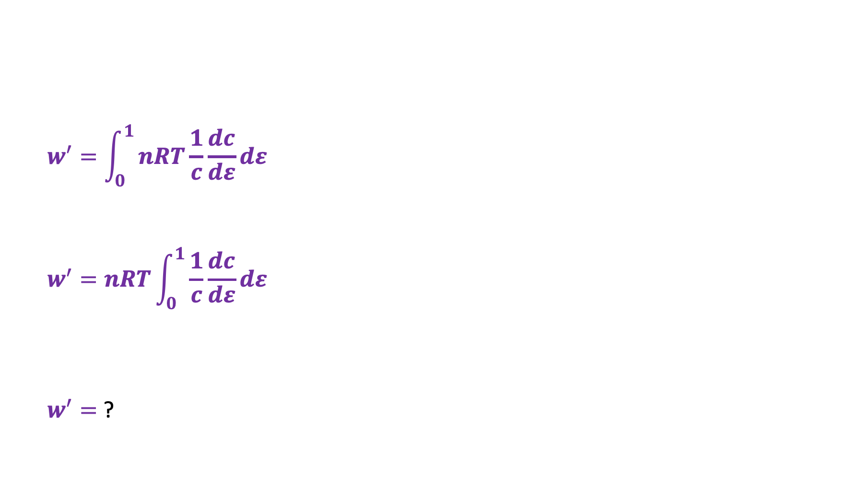
That analytical solution …
$$w^{′}=\int_{0}^{1}{nRT\frac{1}{c}\frac{dc}{dε}}dε$$
$$w^{′}=nRT\int_{0}^{1}{\frac{1}{c}\frac{dc}{dε}}dε$$
$w^{′}=$ ?
Constant temperature
Variable substitution
Don’t forget to reset integration limits too

Slide 26
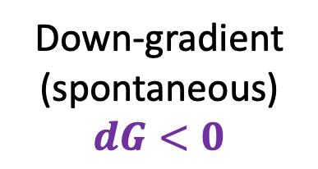
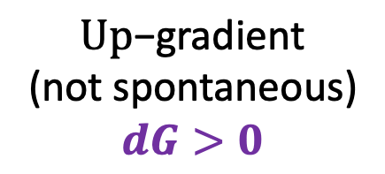
$∆G$ and the 2nd Law: we already could have guessed this, right?
State “X”
(Higher G)
$\text{U}\text{p}\text{−}\text{gradient}$
(not spontaneous)
$$dG>0$$
Down-gradient
(spontaneous)
$$dG<0$$
State “Y”

Slide 27
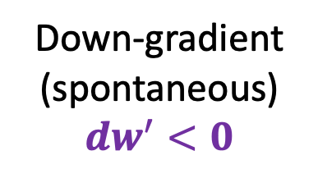
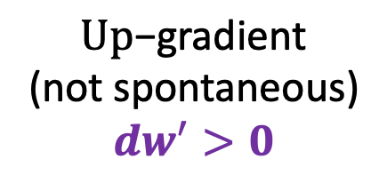
$∆G$ and the 2nd Law: we already could have guessed this too, right?
State “X”
(Higher G)
$\text{U}\text{p}\text{−}\text{gradient}$
(not spontaneous)
$${dw}^{′}>0$$
Down-gradient
(spontaneous)
$${dw}^{′}<0$$
State “Y”

Slide 28
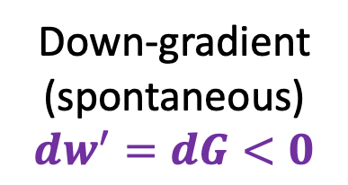
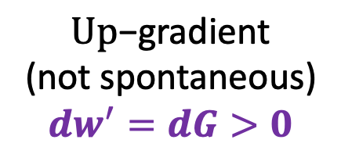
Reversible non-PV work equals the change in Gibbs energy!
State “X”
(Higher G)
$\text{U}\text{p}\text{−}\text{gradient}$
(not spontaneous)
$${dw}^{′}=dG>0$$
Down-gradient
(spontaneous)
$${dw}^{′}=dG<0$$
State “Y”

Slide 29
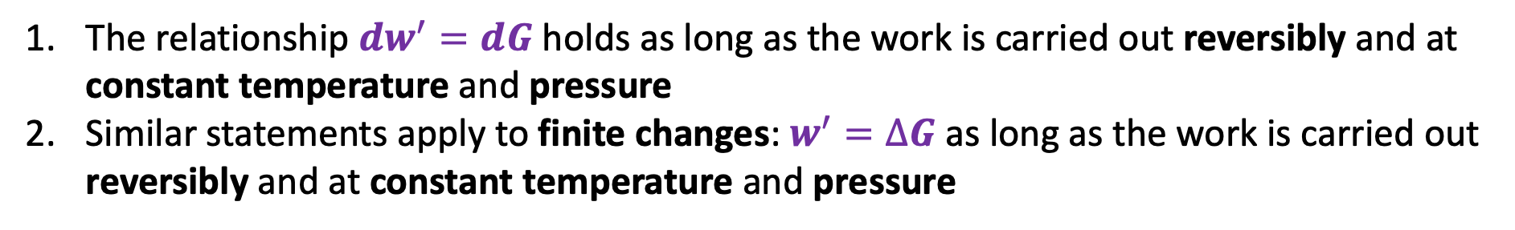
Reversible non-PV work equals the change in Gibbs energy!
State “X”
(Higher G)
$\text{U}\text{p}\text{−}\text{gradient}$
(not spontaneous)
$${dw}^{′}=dG>0$$
Down-gradient
(spontaneous)
$${dw}^{′}=dG<0$$
State “Y”
The relationship ${dw}^{′}=dG$ holds as long as the work is carried out reversibly and at constant temperature and pressure
Similar statements apply to finite changes: $w^{′}=∆G$ as long as the work is carried out reversibly and at constant temperature and pressure

Slide 30
What we learned …
How to write the force and calculate the non-PV work associated with electrical gradients
How to write the force and calculate the non-PV work associated with concentration gradients
State what the sign of the work tells us about spontaneity
State the conditions under which these forms of non-PV work equal the change in Gibbs energy (reversible, isobaric, and isothermal)

